Slide 1
Linear Regression

Slide 2
What Is Regression?
Regression searches for relationships among variables.
For example, you can observe several employees of some company and try to understand how their salaries depend on their features, such as
experience, education level, role, city of employment, and so on.
This is a regression problem:
where data related to each employee represents one observation. The presumption is that the experience, education, role, and city are the independent features, while the salary depends on them.
Similarly, you can try to establish the mathematical dependence of housing prices on area, number of bedrooms, distance to the city center, and so on.

Slide 3
What Is Regression?
Generally, in regression analysis, you consider some phenomenon of interest and have a number of observations.
Each observation has two or more features. Following the assumption that at least one of the features depends on the others, you try to establish a relation among them.
In other words, you need to find a function that maps some features or variables to others sufficiently well.

Slide 4
What Is Regression?
The dependent features are called the dependent variables, outputs, or responses. The independent features are called the independent variables, inputs, regressors, or predictors.
It’s a common practice to denote the outputs with 𝑦 and the inputs with 𝑥. If there are two or more independent variables, then they can be represented as the vector 𝐱 = (𝑥₁, …, 𝑥ᵣ), where 𝑟 is the number of inputs.

Slide 5
When Do You Need Regression?
Typically, you need regression to answer whether and how some phenomenon influences the other or how several variables are related.
For example, you can use it to determine if and to what extent experience or gender impacts salaries.
Regression is also useful when you want to forecast a response using a new set of predictors.
For example, you could try to predict electricity consumption of a household for the next hour given the outdoor temperature, time of day, and number of residents in that household.
Regression is used in many different fields, including economics, computer science, and the social sciences. Its importance rises every day with the availability of large amounts of data and increased awareness of the practical value of data.

Slide 6
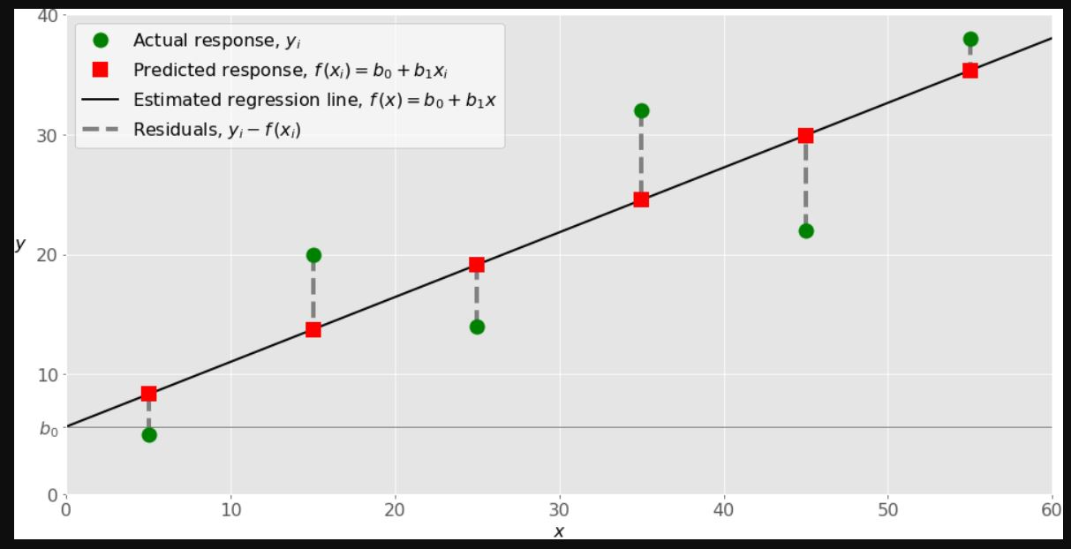
Linear Regression

Slide 7

Linear Regression
When implementing simple linear regression, you typically start with a given set of input-output (𝑥-𝑦) pairs.
These pairs are your observations, shown as green circles in the figure. For example, the leftmost observation has the input 𝑥 = 5 and the actual output, or response, 𝑦 = 5. The next one has 𝑥 = 15 and 𝑦 = 20, and so on.
The estimated regression function, represented by the black line, has the equation 𝑓(𝑥) = 𝑏₀ + 𝑏₁𝑥.
Your goal is to calculate the optimal values of the predicted weights 𝑏₀ and 𝑏₁ that minimize Standard Estimation Error. Formula of SER
$$\sqrt{\frac{\sum{(y−{}_{y}^{−})2}}{n−2}}$$

Slide 8

Linear Regression
The value of 𝑏₀, also called the intercept, shows the point where the estimated regression line crosses the 𝑦 axis. It’s the value of the estimated response 𝑓(𝑥) for 𝑥 = 0.
The value of 𝑏₁ determines the slope of the estimated regression line.
$$\frac{\sum{(x−{}_{x}^{−})(y−{}_{y}^{−})}}{\sum{(x−{}_{x}^{−})2}}$$
The predicted responses, shown as red squares, are the points on the regression line that correspond to the input values. For example, for the input 𝑥 = 5, the predicted response is 𝑓(5) = 8.33, which the leftmost red square represents.
The vertical dashed grey lines represent the residuals (error), which can be calculated as 𝑦ᵢ - 𝑓(𝐱ᵢ) = 𝑦ᵢ - 𝑏₀ - 𝑏₁𝑥ᵢ for 𝑖 = 1, …, 𝑛. They’re the distances between the green circles and red squares.

